Slide 1
Software Requirements Evolution*
D. A. Tamburri, Ph.D.
*Slides courtesy of Prof. Dr. Alex Serebrenik@TUe

Slide 2

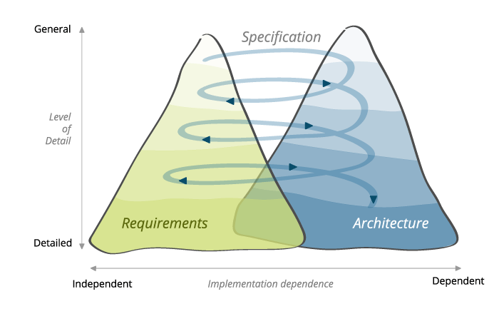

Slide 3
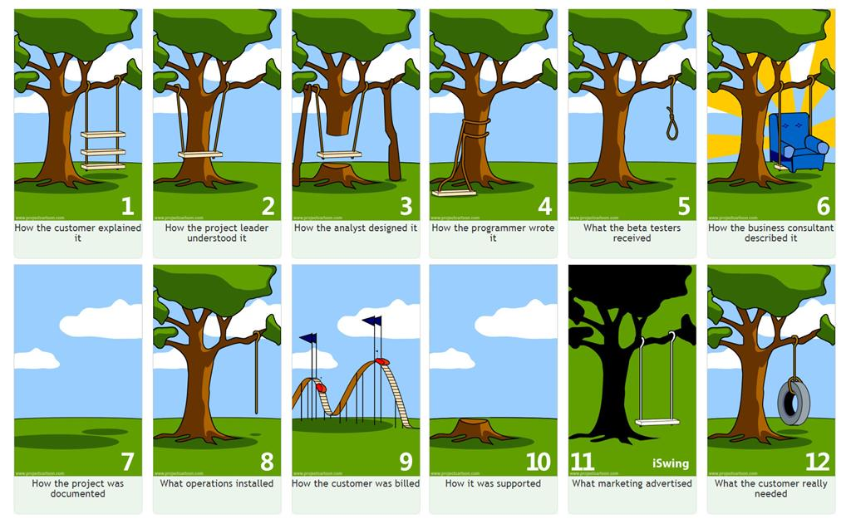

Slide 4
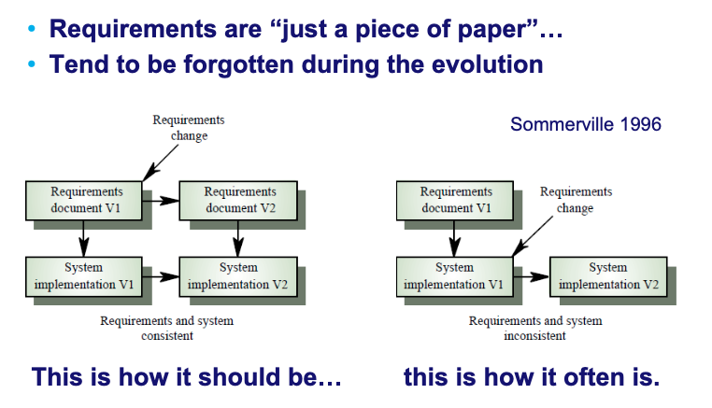
Requirements Evolution

Slide 5
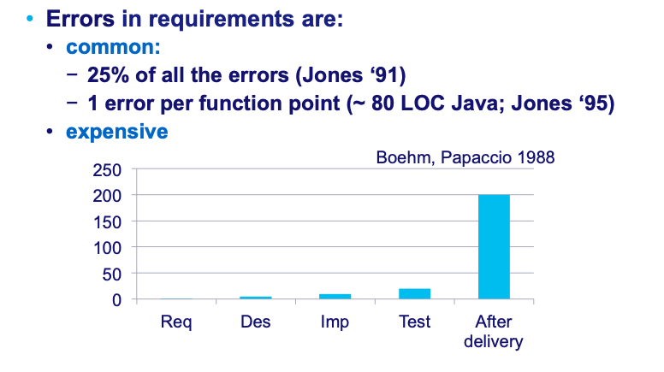
Why requirements?

Slide 6
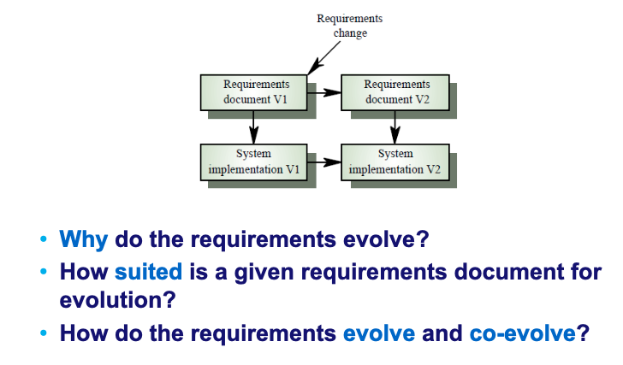

Slide 7
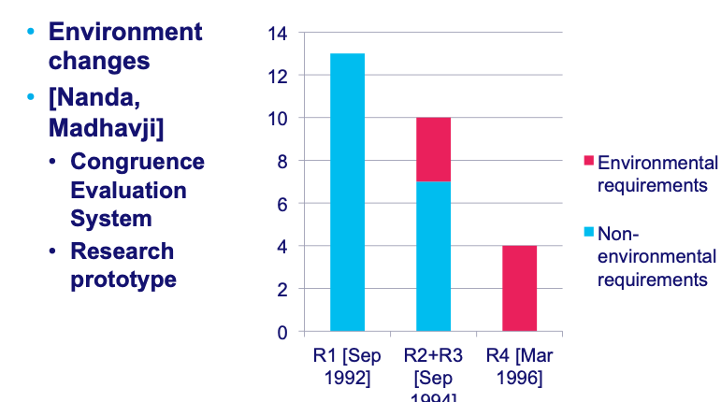
Why do the requirements evolve?

Slide 8
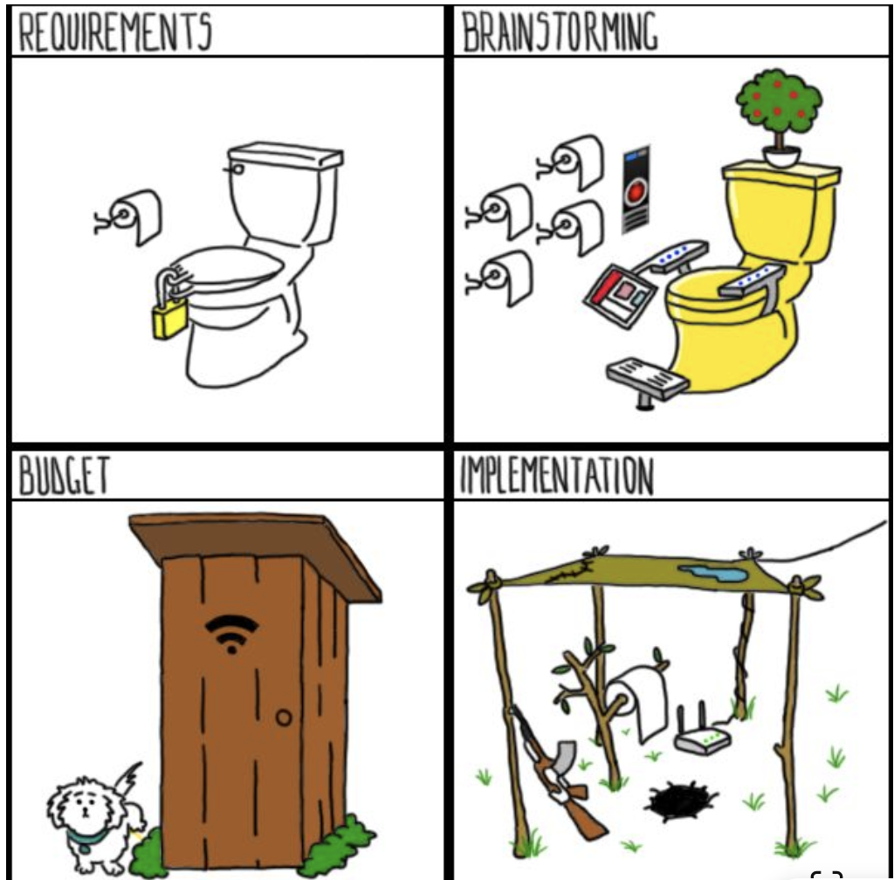

Slide 9
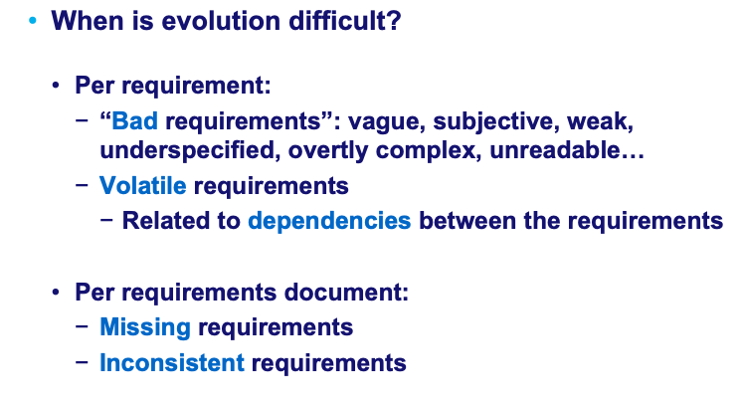
Suitability for evolution

Slide 10
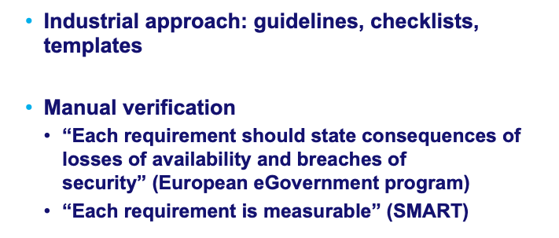
Spotting bad requirements: Evolution & Quality check lists

Slide 11
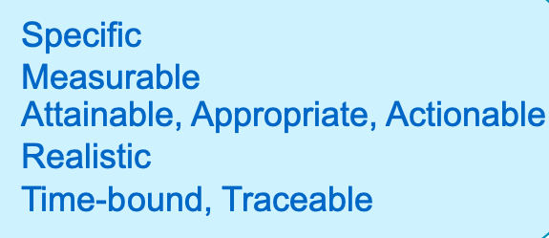
The SMART approach

Slide 12
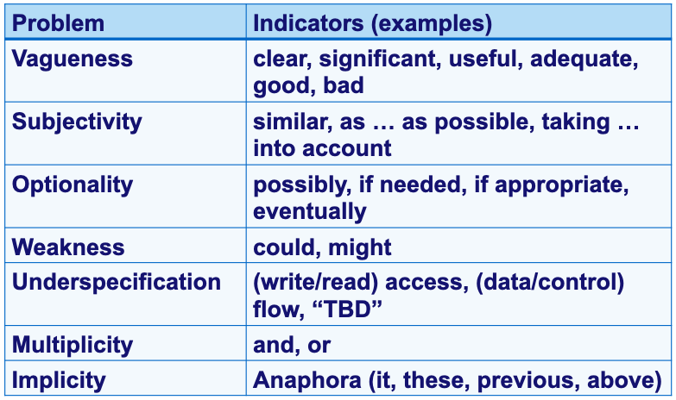
Bad requirements: More automation?*
* Fabbrini, Fusani, Gnesi, Lami, 2001.

Slide 13
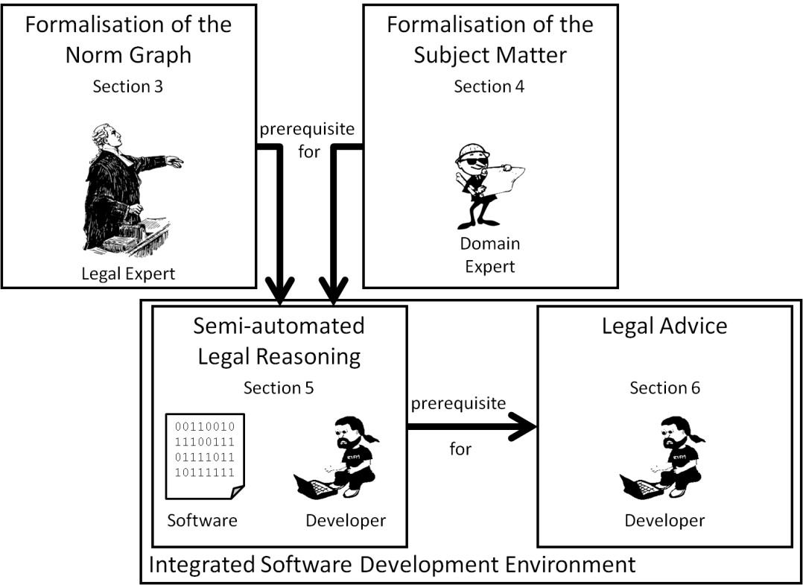

Slide 14
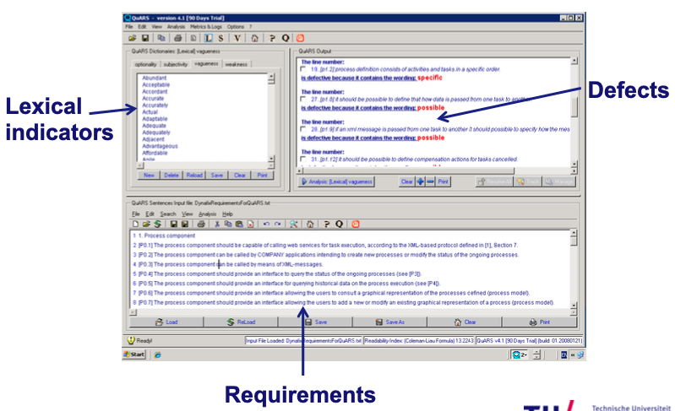

Slide 15
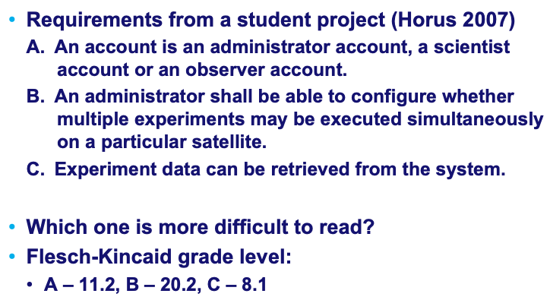
Readability measurement

Slide 16
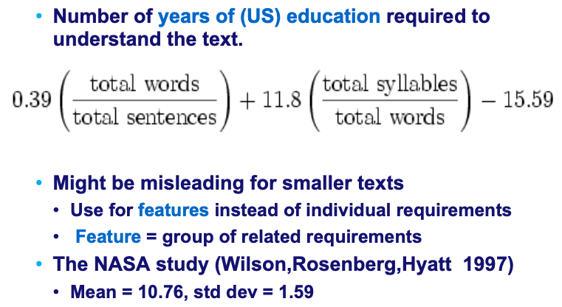
Flesch-Kincaid grade level

Slide 17
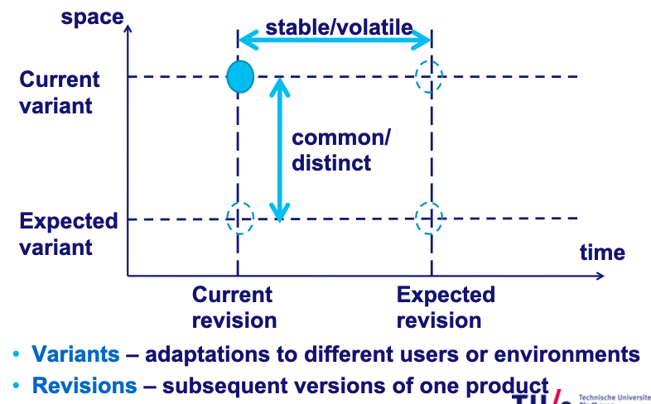
Second problem: Volatile requirements

Slide 18
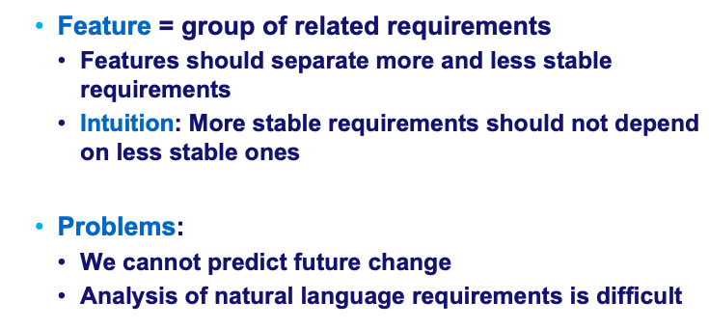
How can we identify volatile requirements?

Slide 19
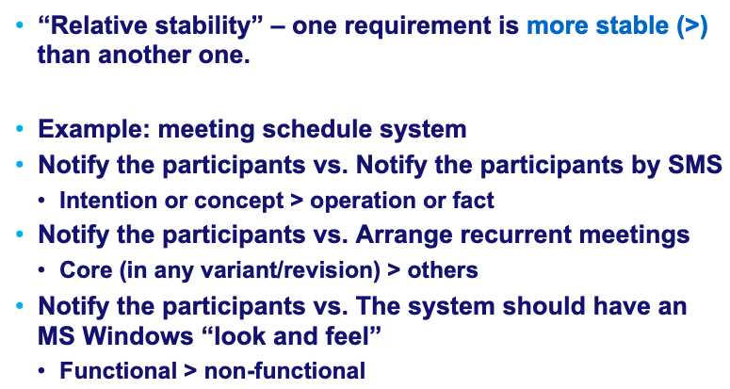
Relative stability
NB: Conflicts and choices among different options are
usually quite volatile!

Slide 20
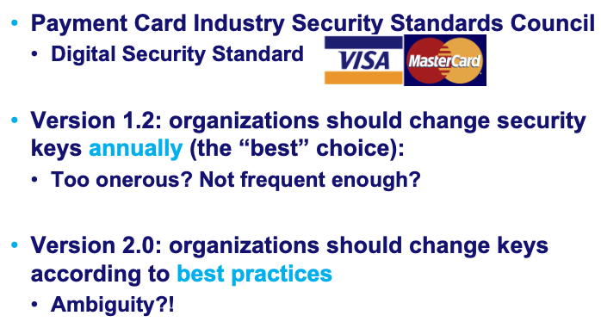
Conflicts and choices among different options are usually quite volatile: Example

Slide 21
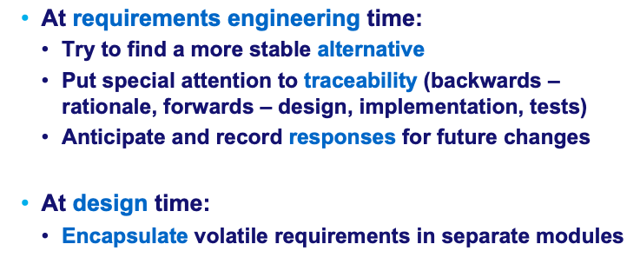
How can we address volatility?

Slide 22
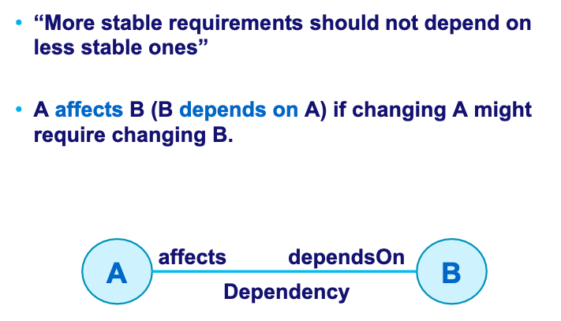
Volatility and dependencies

Slide 23
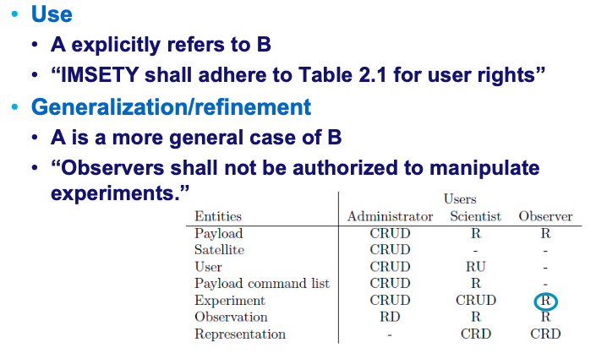
Types of dependencies (examples)

Slide 24
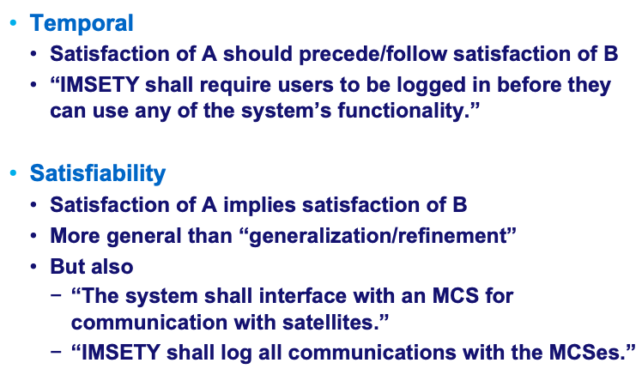
Types of dependencies (examples, continued)

Slide 25
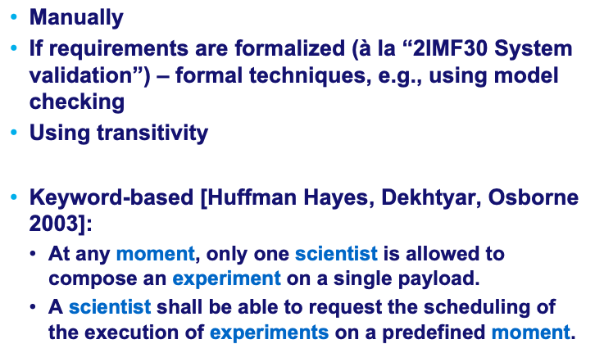
How can we derive dependency relations?

Slide 26
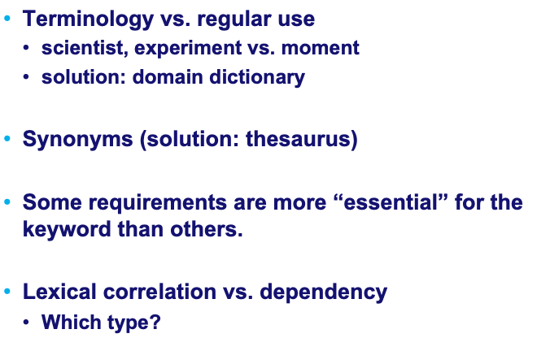
Problems (and solutions) with keyword-based

Slide 27
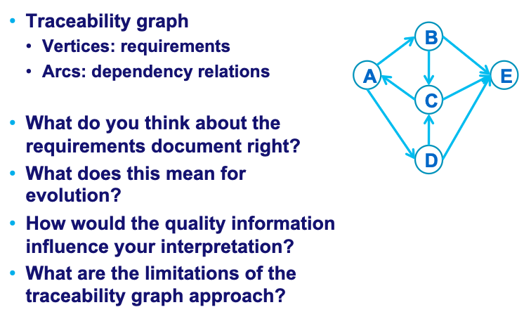
Dependency analysis

Slide 28
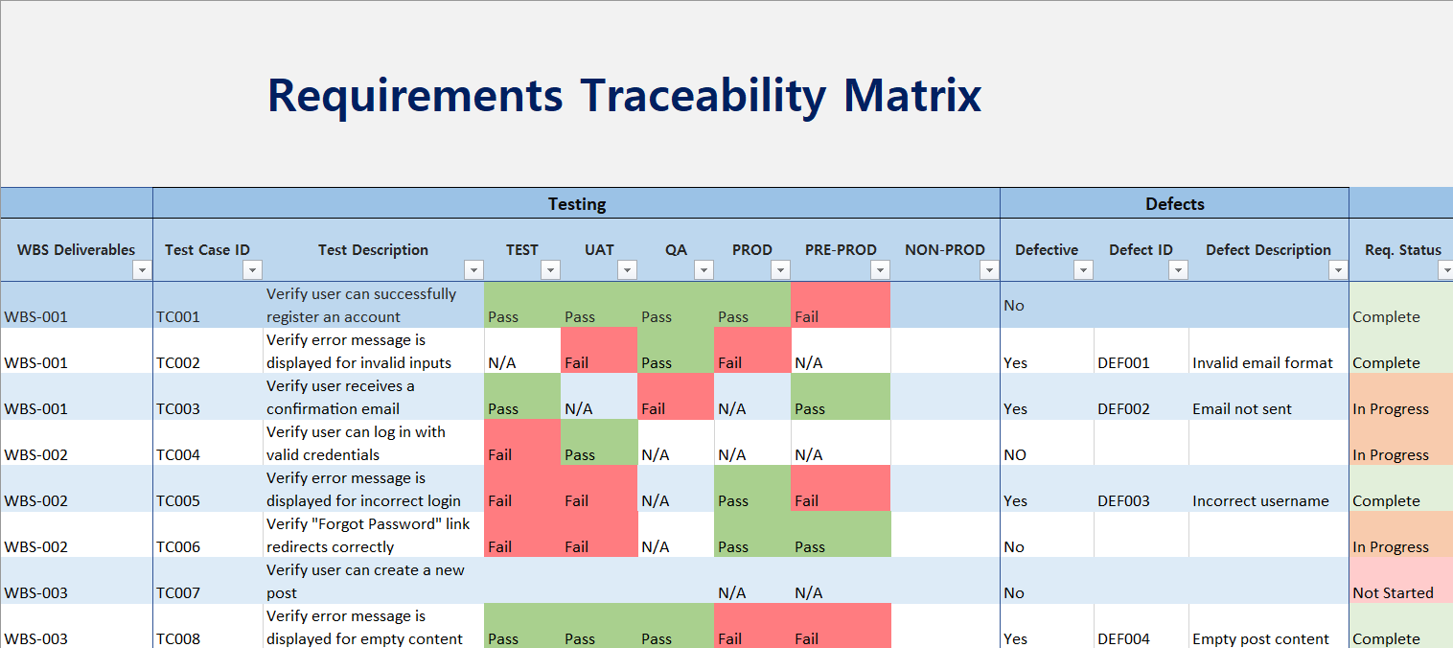

Slide 29
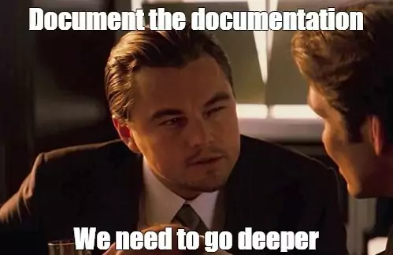

Slide 30
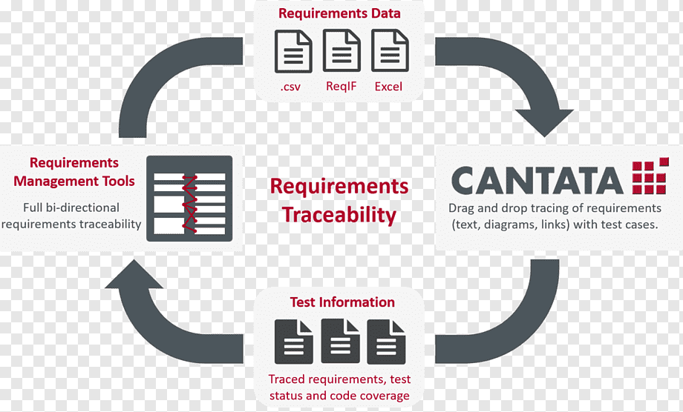

Slide 31
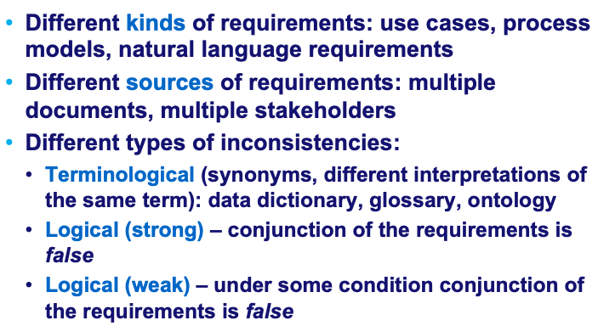
Inconsistent requirements

Slide 32
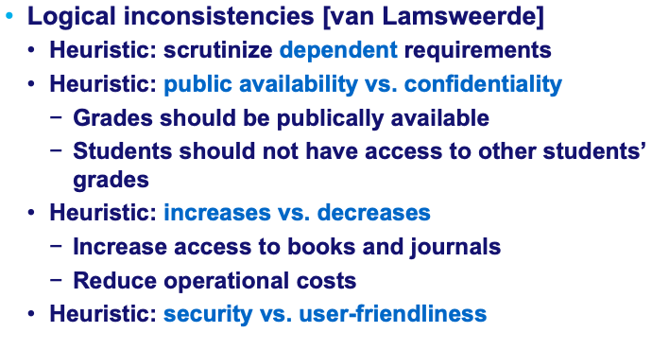
Logical inconsistencies: Heuristics

Slide 33
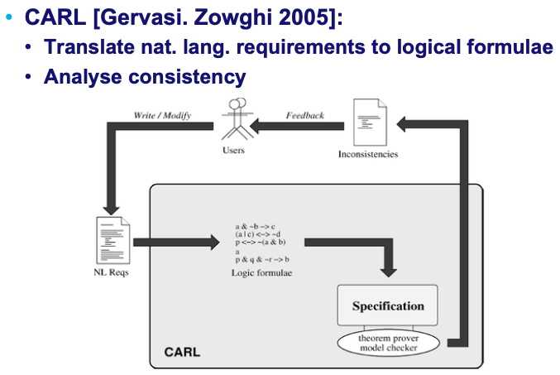
Inconsistent requirements: Linguistics+Logics

Slide 34
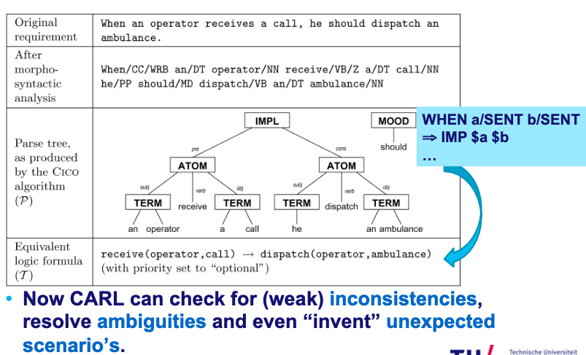
CARL: From text to formula

Slide 35
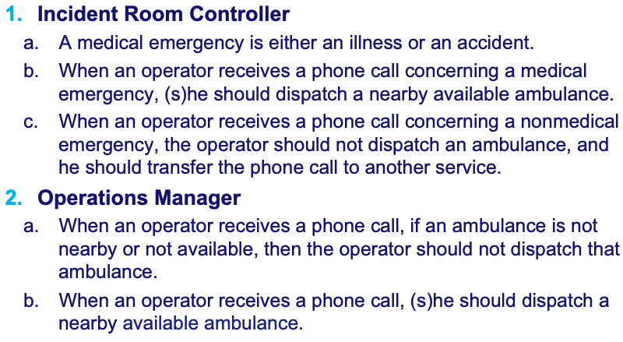
CARL: Detect inconsistency

Slide 36
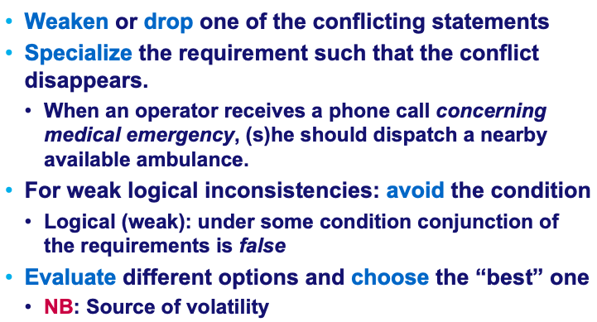
How can we address inconsistency?

Slide 37
Recap
Requirements evolution can be hindered by
“Bad requirements”: vague, subjective, weak, underspecified, overtly complex, unreadable…
Volatile requirements
Related to dependencies between the requirements
Missing requirements
Inconsistent requirements

Slide 38
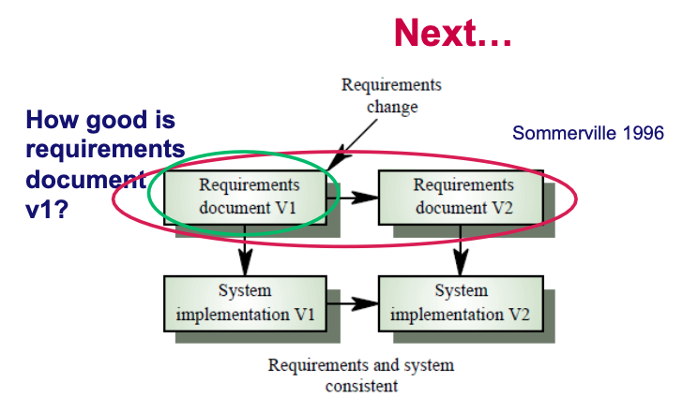

Slide 39
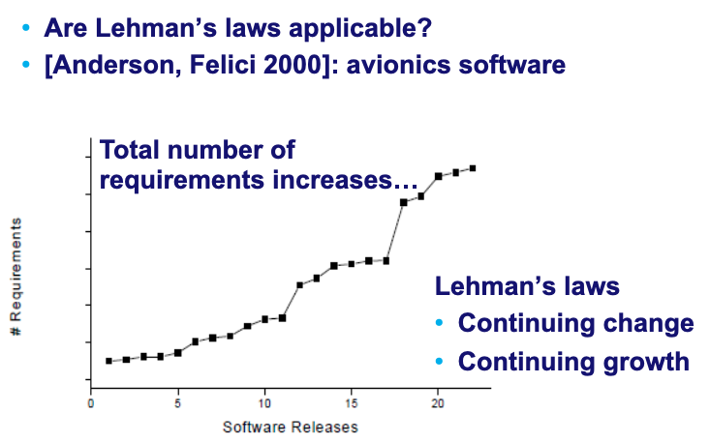
How do the requirements evolve?

Slide 40
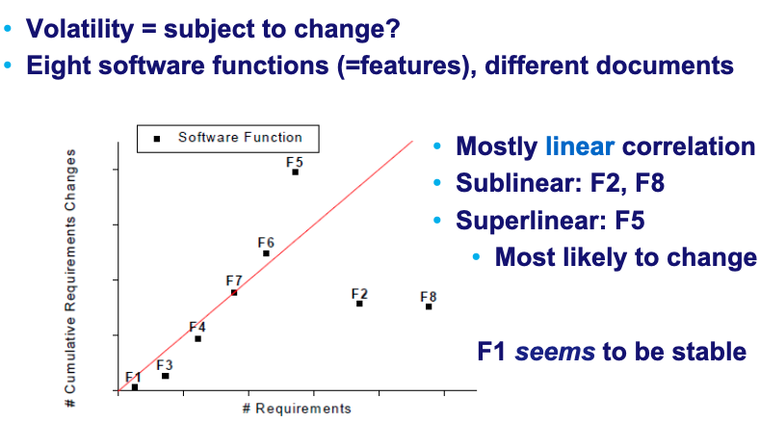
Evolution and volatility

Slide 41
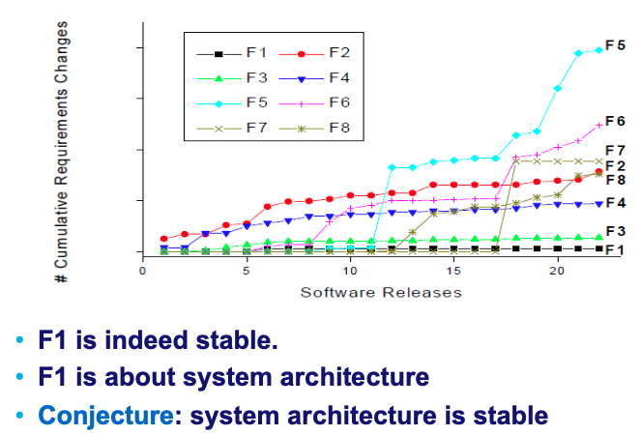
Closer look at the 8 functions (1)

Slide 42
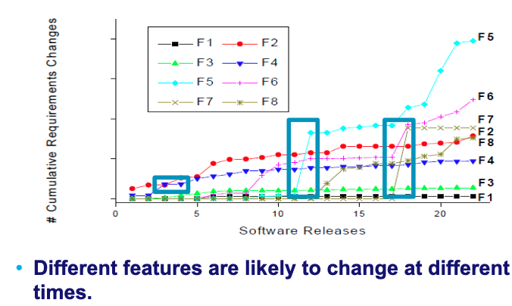
Closer look at the 8 functions (2)

Slide 43
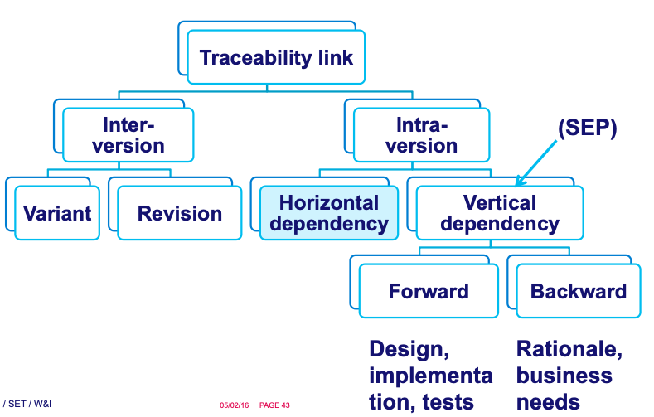
Co-evolution: Traceability links!

Slide 44
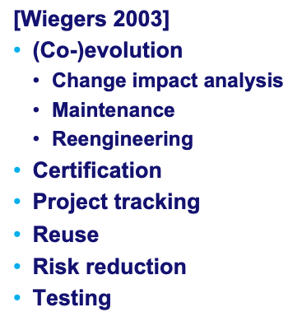
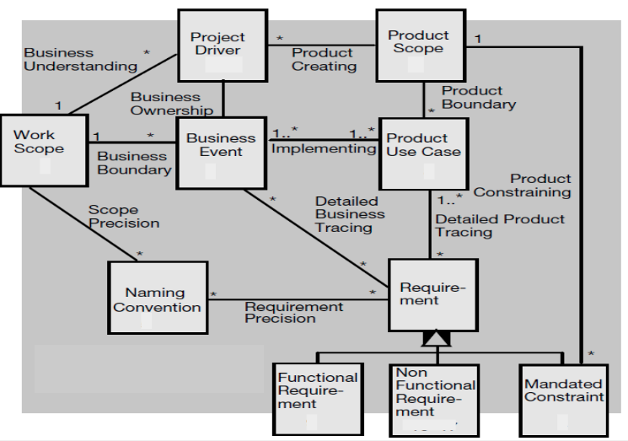
Why traceability?
Other Dependencies?

Slide 45
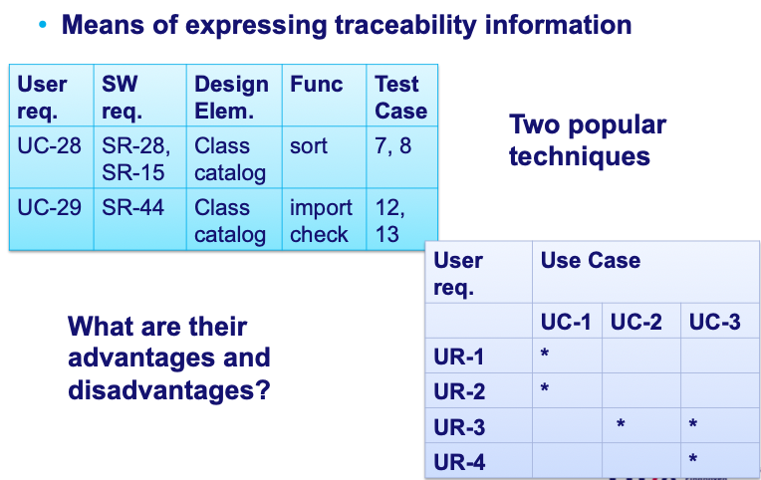
Traceability matrix

Slide 46
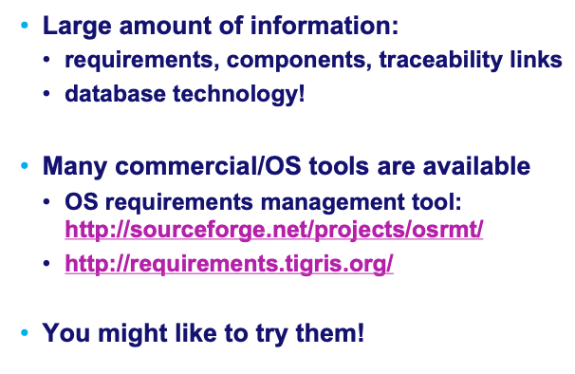
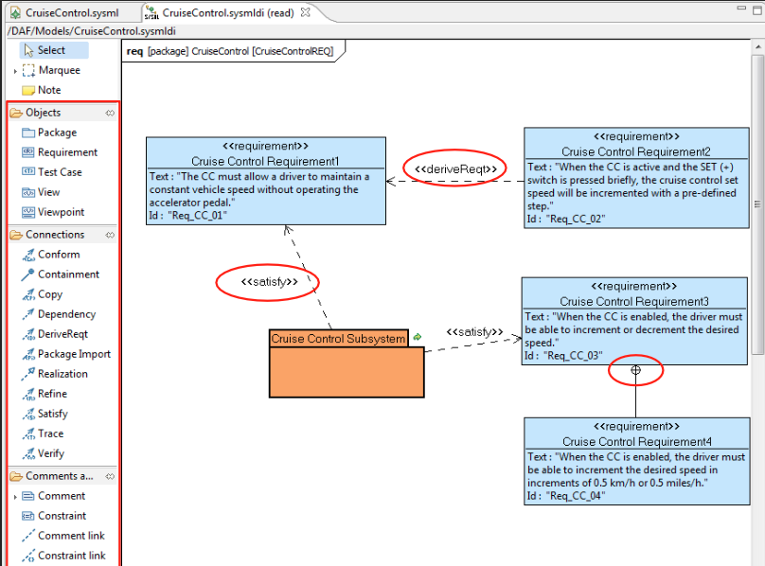
Does it scale?

Slide 47
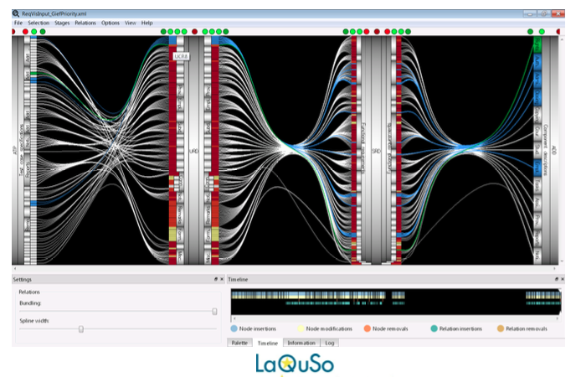
TraceVis!*
*M.Sc. thesis of Wiljan van Ravensteijn 2011

Slide 48
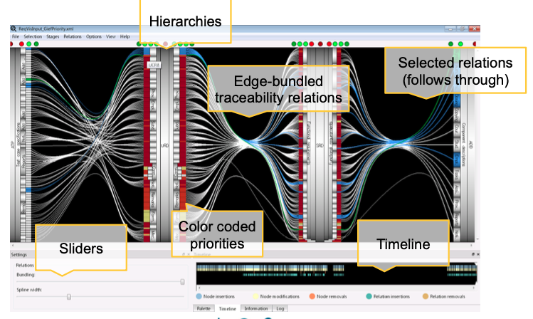

Slide 49
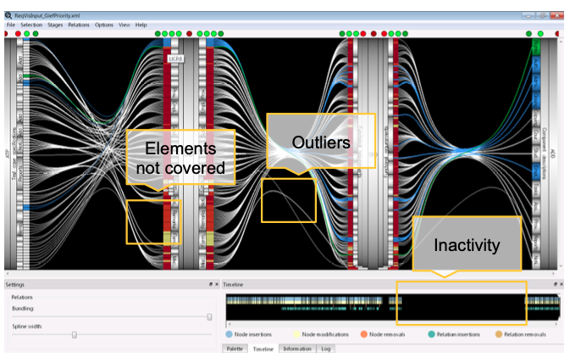

Slide 50
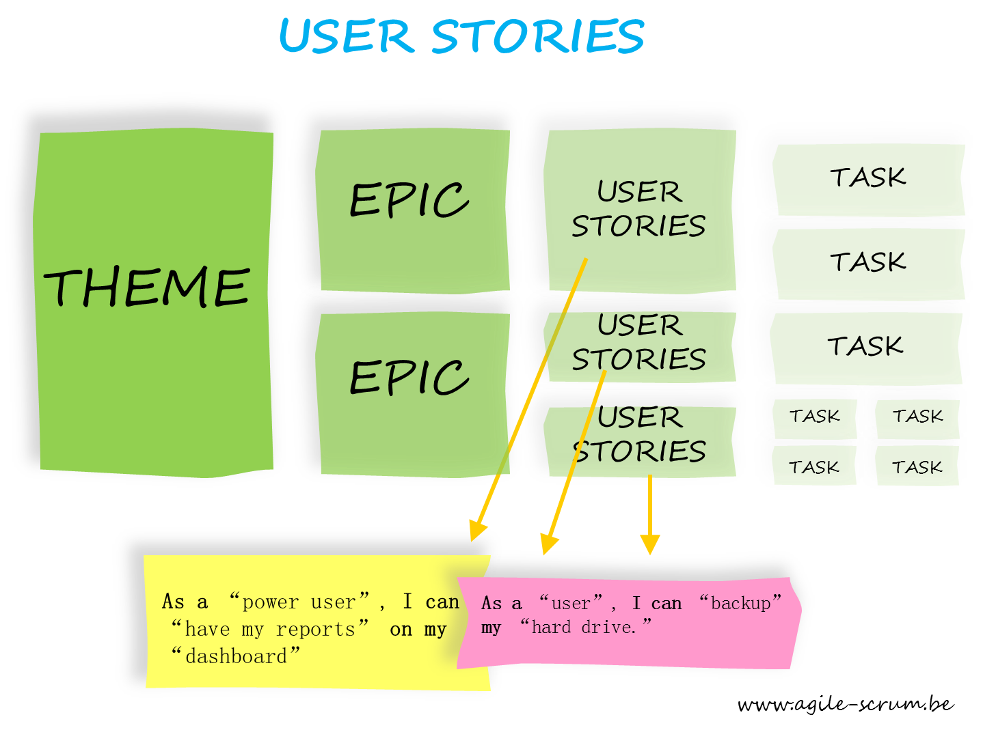
In reality, nowadays…

Slide 51








Independent Agile Consulting
Founder at Nexxle
Chief Agilist
Enterprise Transformation
Built Agile Delivery team
800 Team Transformation
Acquired by
Founder, CEO, CTO
Past President

Slide 52
User Stories
Components of a User Story
Who: iOS user
What: redundant copy of data on device
Why: in case of accidental changes
iOS user wants redundant copy of data on device in case of accidental changes
Characteristics of User Stories
Can be implemented in any order
Does not specify how to implement it
Customer/market focused
Small
Something that could be done as a “patch” in a week or less

Slide 53
Bill Wake’s “INVEST” Guidelines
Independent
To the extent possible, stories can be implemented in any order
Negotiable
How to accomplish the goal is left open, no suggested implementation
Valuable to the user
Something the user can actually use, not just a technical task
Estimable
No research required, well understood
Small
Can be taken from concept to ready for release within a couple of weeks and preferably within a couple of days
Testable
It is possible to measure something specific to verify that the story is done

Slide 54
Valuable
Movie-goer wants to add e-tickets to shopping cart to skip line
Not valuable
V3
Movie-goer wants to buy e-tickets via shopping cart to skip line
Valuable
V3

Slide 55
Product > Epics > User Stories
Product: BYOD data backup for large businesses to protect IP
Full backup from device to datacenter
Reporting
User stories are the smallest unit of value
EPIC
EPIC
Android user wants to save/restore notes data for simple backup
Admin wants automated daily reports on storage usage to help spot trends
Secure api to backed up data to support 3pty services (eg anti-virus)
EPIC
EPIC
Quick encrypted backup to connected storage device
iOS user wants redundant copy of data on device in case of accidental changes
EPIC
EPIC
Incremental backups
Backup for older devices

Slide 56
Products to Epics to Stories
Products
Epics
User Stories
(start to prod in < 2 weeks)

Slide 57
Negotiable
Regulator wants name and address entered to validate a customer’s identity
Not negotiable
NT
Regulator wants information entered to validate a customer’s identity
Negotiable
NT

Slide 58
Testable
Shopper wants high availability to be able to shop at any time
Not testable
NT
Shopper wants the system to be down for no more than 5 seconds per week to be able to shop at any time
Testable
NT

Slide 59

Conclusions

Slide 60

Questions?

Slide 61

More about requirements evolution?

Slide 62


